Slide 1



ASAP TOOL
By
Balaji Balasubramani

Slide 2

Business Case
Problem:
Data is very important, Repetitive data requests are raised across teams
Responding requests manually is time consuming and have possibilities of Human error.
Solution:
To build a CUSTOMIZABLE tool which automates the tedious workflow thereby achieving,
More reliability
Time efficiency
Increased Productivity
Cost efficiency

Slide 3
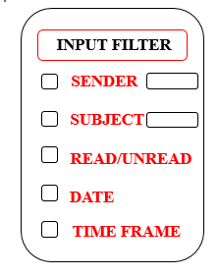
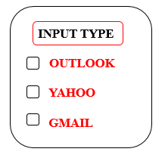
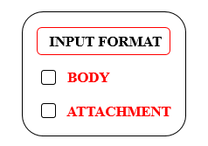
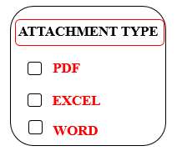
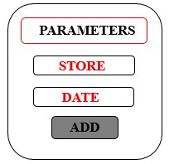


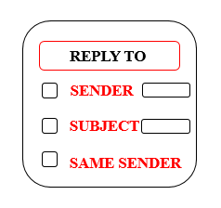
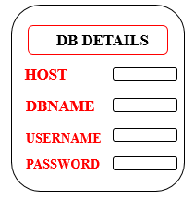
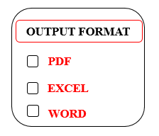
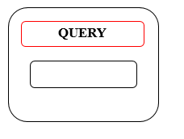
Tool Overview(LLD)

Slide 4


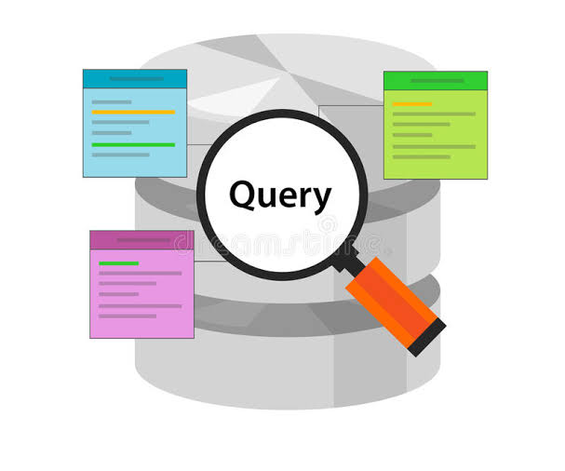



Prototype
Business user
Mail box
Fetching parameters
Querying DB
Storing
in excel
Business user

Slide 5




Technology Stack
Front End
Python flask
Backend
Postgre SQL
Programming language
Python

